Slide 1



Simulated Shopping Cart
Atif Siddiqui

Slide 2


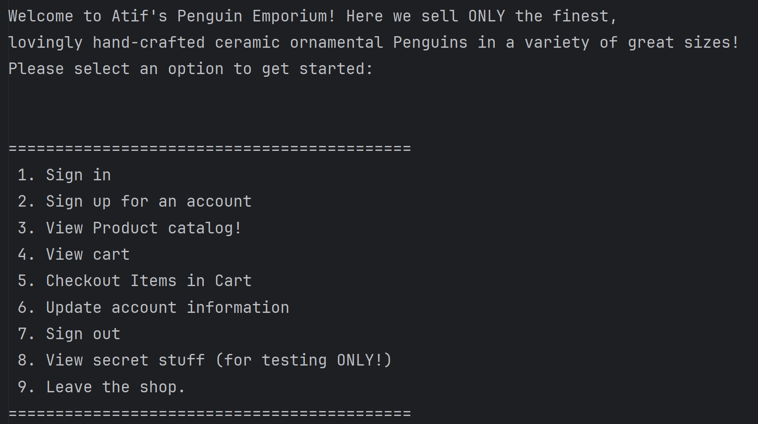
Presentation Breakdown
General Overview
User class and UserList
Products and Products Factory
ShoppingCart Singleton and Builder
Payment Processor and User Details
Testing and Logging
Demo

Slide 3

General Feature Overview
Console Based shopping experience
Penguin Themed
Uses Gradle to make viewing and creating tests easier
Users can sign in/out, view the product catalog, add items to their cart, remove items from their cart, view their cart, view or update their user information, empty their carts, and checkout with their items
Each User has their own cart, but cannot access each others carts and only can checkout when signed in
Can list all users, passwords, and their logged in status from a “secret” menu

Slide 4

Users and UserList and AuthenticateUser
Users are stored in UserList with their passwords and other information if entered
They have flags for if they are logged in or not – set by the Authenticator class
Only one user can be logged in at a time, this was done to prevent users from seeing each other’s carts or information
Users have a cart and an itemList
Users have Username, Name, Password, Credit Card Information, and Addresses
Users are first only prompted to enter their username and password to sign up
Users can view items, but cannot add them to the cart if they are not signed in
UserList is responsible for managing the UserList that is checked whenever a person signs in, or does any action that triggers checks for a sign in
Uses a Hashmap to make retrieving details easy and seamless
Calls to the Authenticator Class to set Logged in and handle the loggedin user
Since only one user is designated as the logged in user, only one user can access the cart
All Users currently signed up are viewable because of this approach
An example of SRP

Slide 5

Products, ProductCatalog, And Product Factory
The Product interface
Product Factory
Products are relatively simple but can be extended to be more complex, utilizing the Open/close principle, the Liskov substitution, and interface separation.
Currently held in a list of all products, which can be added to at any time, and then once the program runs, the menu and number of items will update almost automatically (just have to add buttons/choices for them, but the products themselves will show up in the list)
The product factory utilizes the factory design pattern to make creation and management of products easy
The product catalog uses the factory method to add items to the list of all products
This is done during initialization of the program so that the catalog is always up to date
Products can also be added in multiples and the price will update accordingly

Slide 6
ShoppingCart Singleton and Builder
Shopping Cart Singleton
Builder
Uses a Map to hold all the users carts separately but simultaneously, not first solution
Uses eager initialization to simulate real online shopping
Cart is updated whenever it is called, so item indices are always correct
Uses the products to create separate instances of the “same” type of products
Has the ability to go to checkout, and remove items like in real life
Builder adds and removes items to the carts and builds the cart by associating the itemList with the user that is currently logged in.
This allows the cart itself to remain consistent across users, while also allowing to switch users quickly and easily.

Slide 7
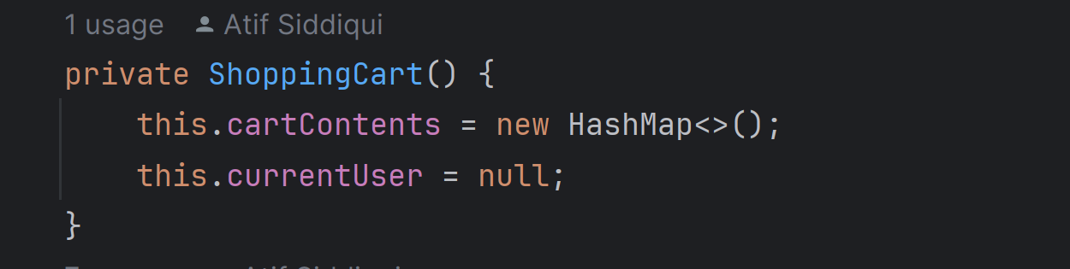
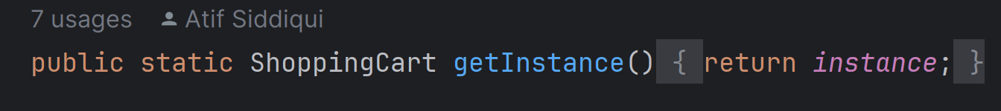
A private constructor and a publicly accessible instance

Slide 8
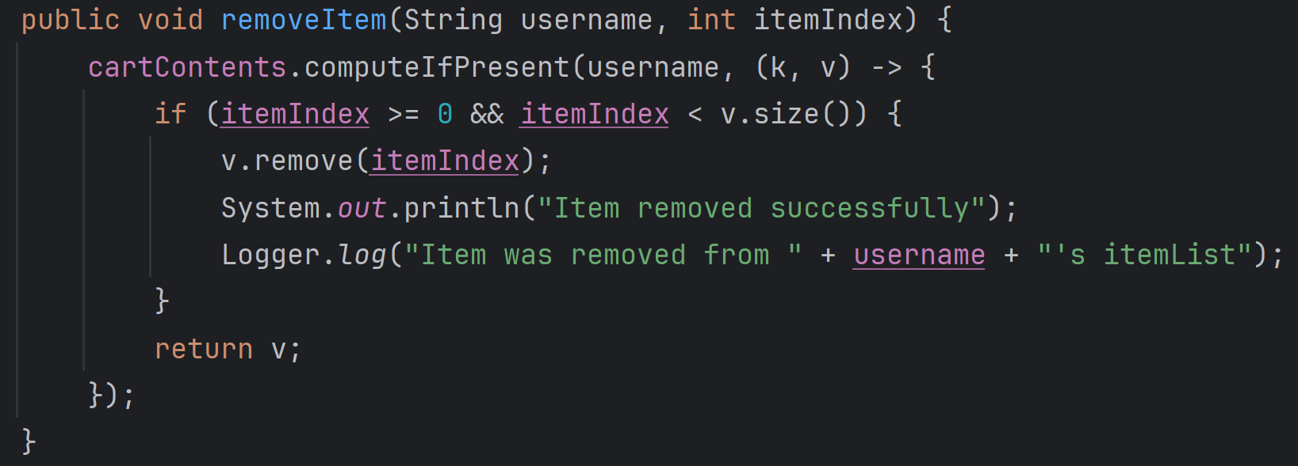
An example of flexible design. No matter how many items there are, the remove will always function based
on what is visible on screen when the cart is being shown

Slide 9

Payment Processing
Separate module that uses Dependency injection. Retrieves user information, product information, and cart information.
When User has not filled in their account information, it asks them to fill it out before hand, ensuring the cart and user info is never empty when the order goes through
Allows user to return to the main menu as well
Adds/accesses the information in the cart to update cost, so it touches all areas of the program in a way
An example of different elements coming
together cohesively like the payment processor

Slide 10
Testing and Logging
Unit tests have been made for the most critical components of the program, the cart, products and users/user authentication
Uses Gradle framework
Logging is handled via a small class that can log any message and be placed anywhere.
Currently can check log.txt to see it is quite extensive and a lot of areas are logged currently to ensure smooth operation

Slide 11
Conclusion
The design choices were made to provide a smooth yet realistic experience
The cart was the most difficult part, took many attempts to get it to function correctly
The code is very easy to add on to and allows for extension via coding best practices
Only a few products were used as a showcase and to reduce the number of possible prompts appearing on the screen, but the design allows for far more implementations if one desires
Testing was done to ensure that functions behave correctly

